Slide 1
BTT Recorder v1.4
Recording from project management
Oral Translations
With source audio

Slide 2
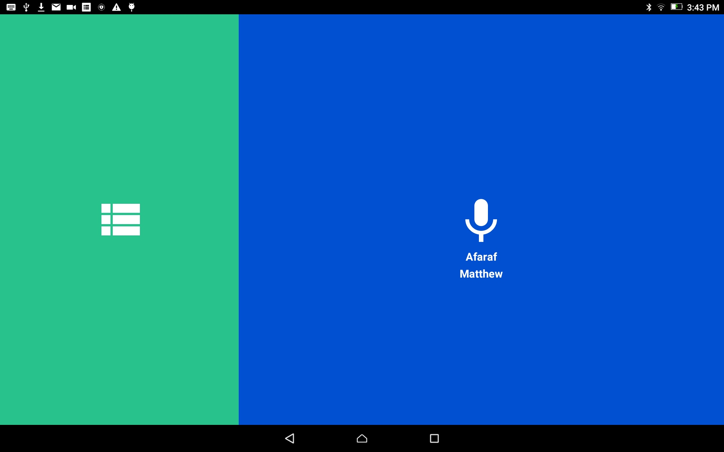
Oral Translations
From the home screen, tap in the green area to open the Project Management screen.
This step is for when the user returns to a recording session

Slide 3
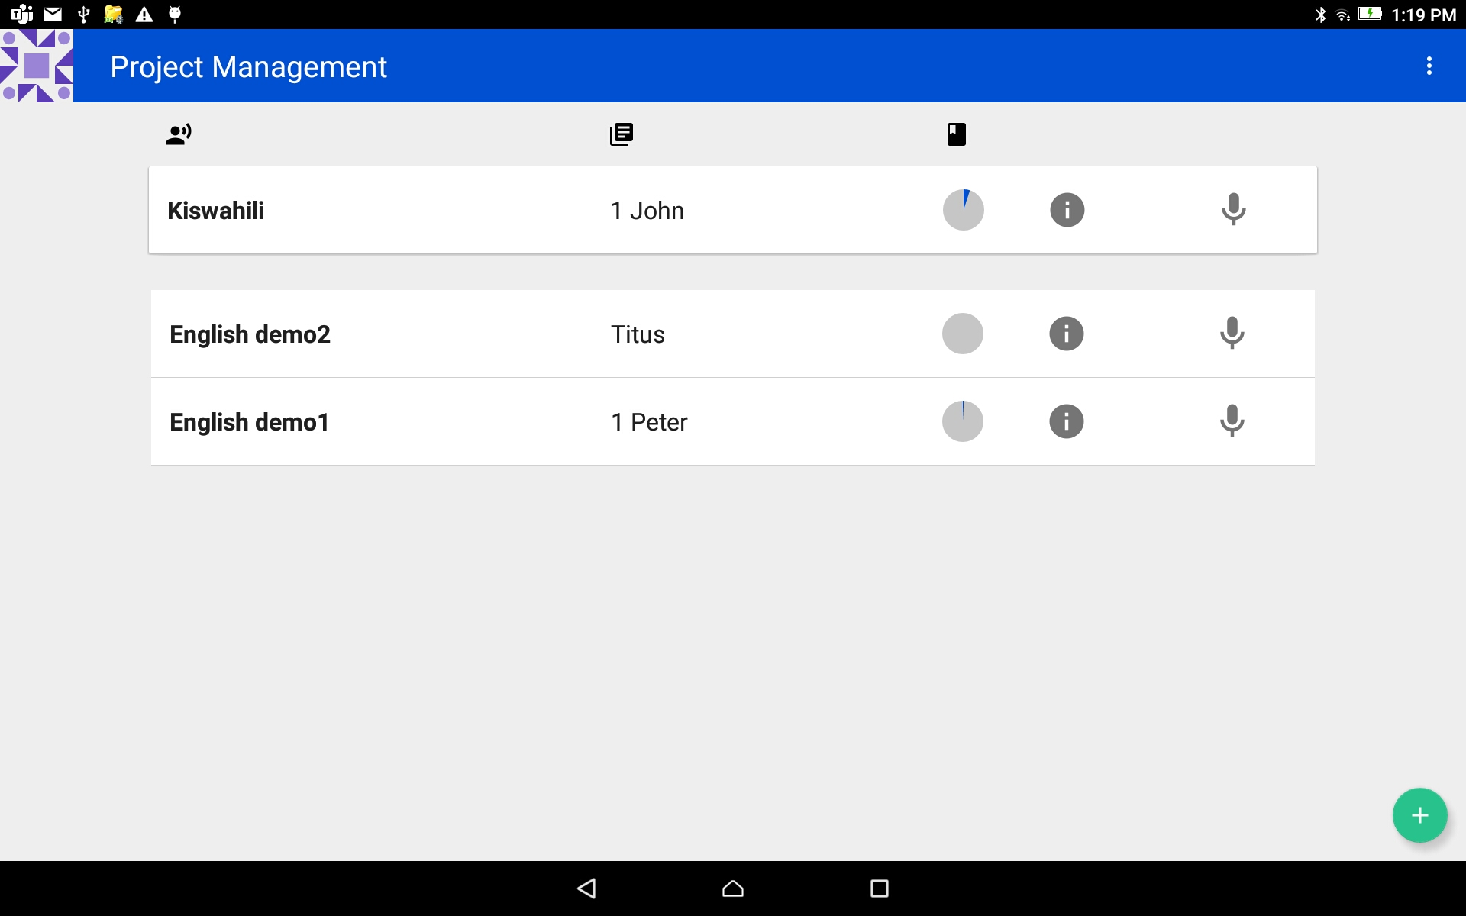
Oral Translations
Tap on the project bar to open the project.
The project that was worked on last is at the top of the list.

Slide 4
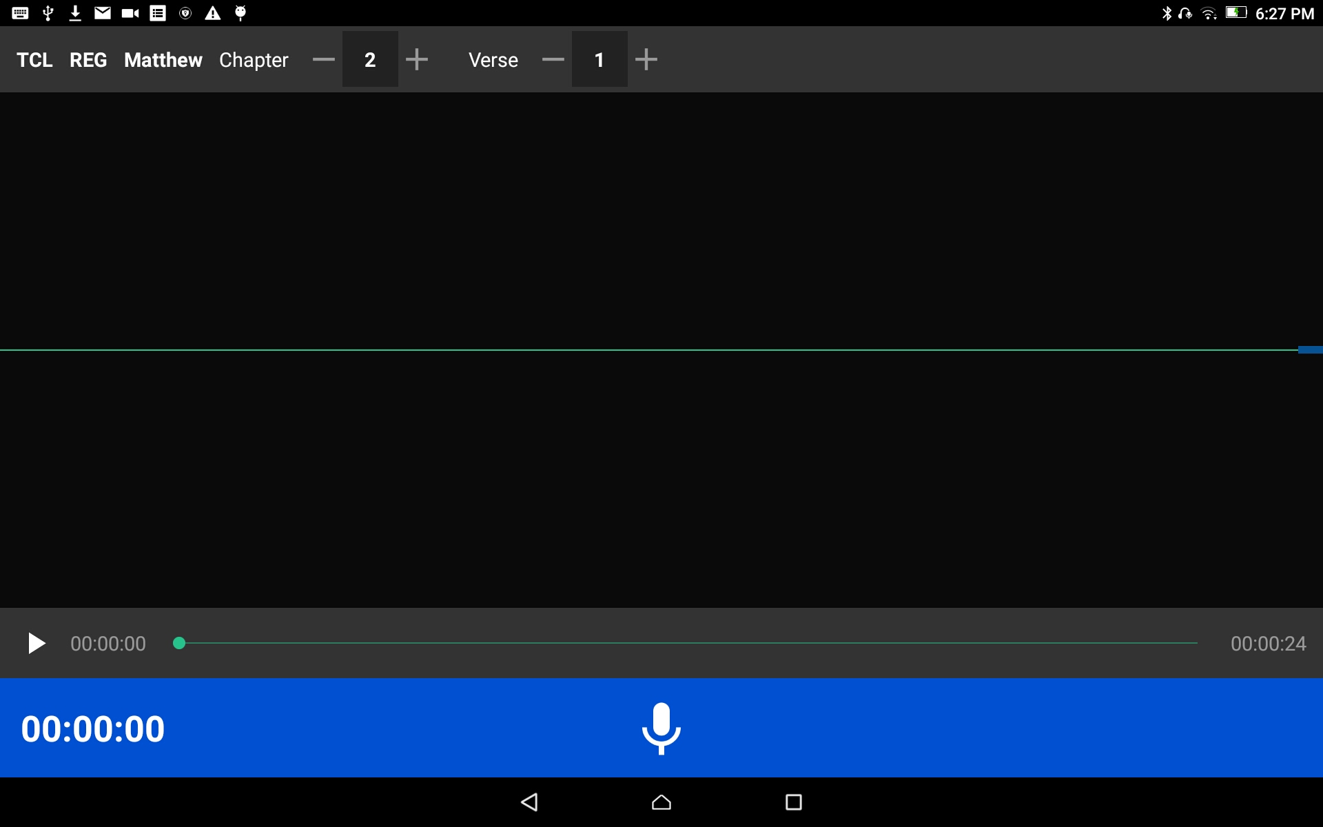
Oral Translations
The Project Opens

Slide 5

Oral Translations
Check the information on the top gray bar:
Target Language
Project Type
Book
Chapter
Chapter #
Verse or Chunk
Verse or Chunk Number

Slide 6
Oral Translations
Check the information on the top gray bar:
Choose the plus and minus signs to change the numbers

Slide 7

Oral Translations
Listen to the Source Audio
Tap on the play Source Audio icon.
Listen to the source audio.

Slide 8
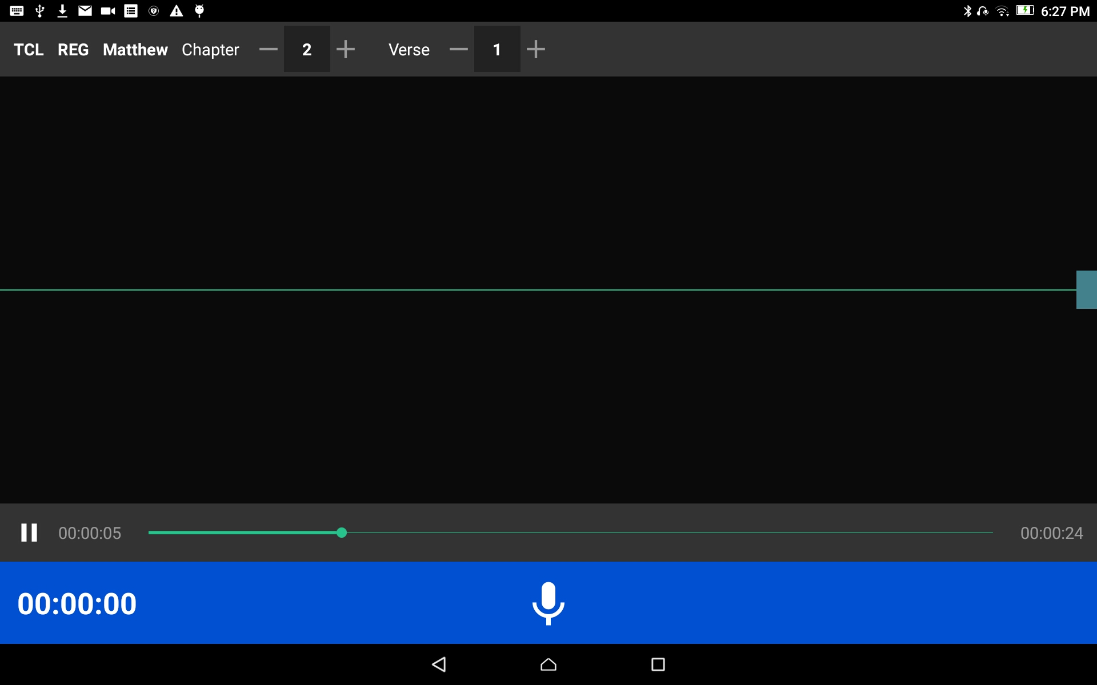
Oral Translations
Listen to the Source Audio
Tap on the 2-vertical lines to pause the audio.
Tap-hold-drag the green dot to go to another place in the audio.

Slide 9
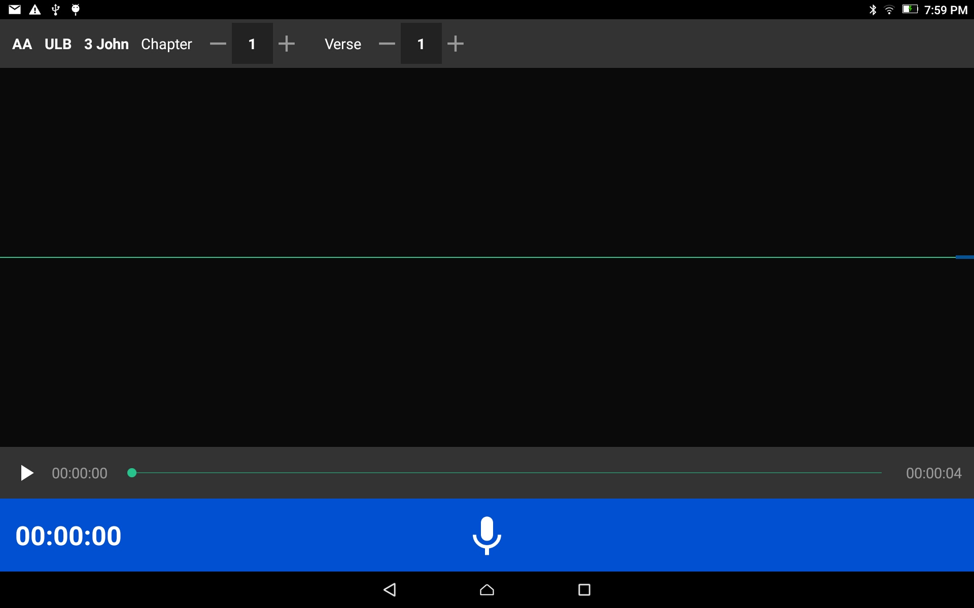
Oral Translations
Ready to record the translation?
Tap on the microphone icon on the blue bar.

Slide 10
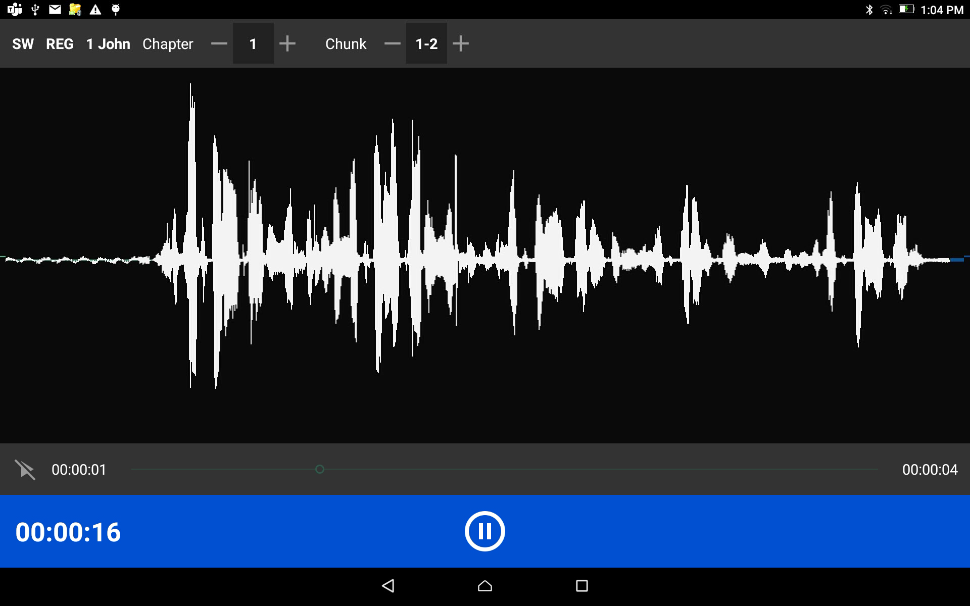
Oral Translations
As you begin to speak you will see lines appear on the screen which is a result of the sound of your voice.
These lines are known as waves.

Slide 11
Oral Translations
When done with that portion, tap the pause button.
Optional - Tap on the microphone icon to start recording again.

Slide 12
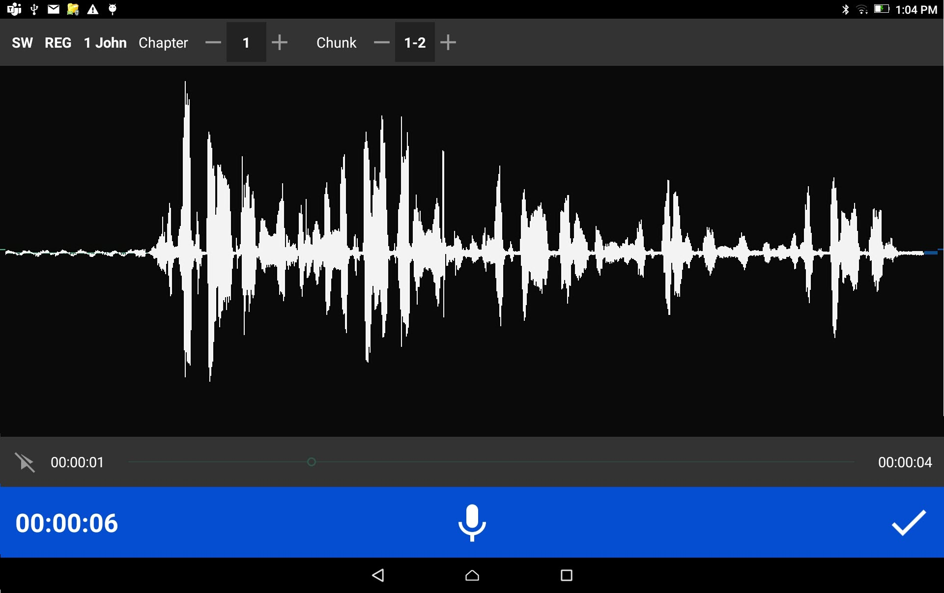
Oral Translations
Tap the checkmark to save the recording.

Slide 13
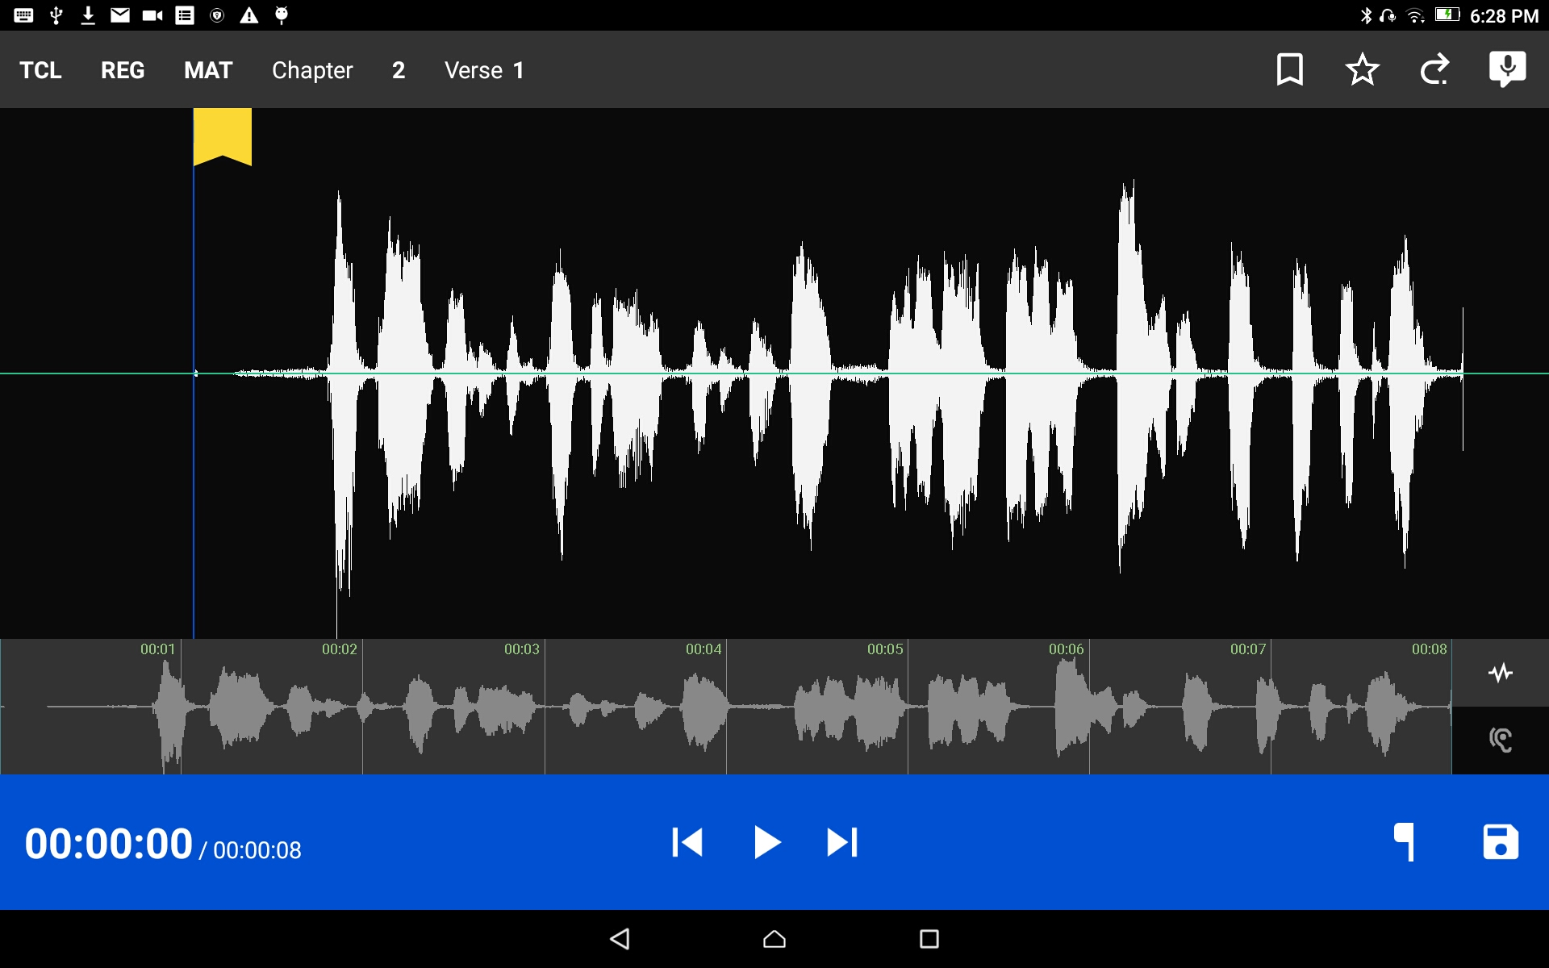
Oral Translations
Tap the SD disk icon to save the recording and continue recording more verses or chunks of the source text.
The program returns to the Project Management screen.

Slide 14
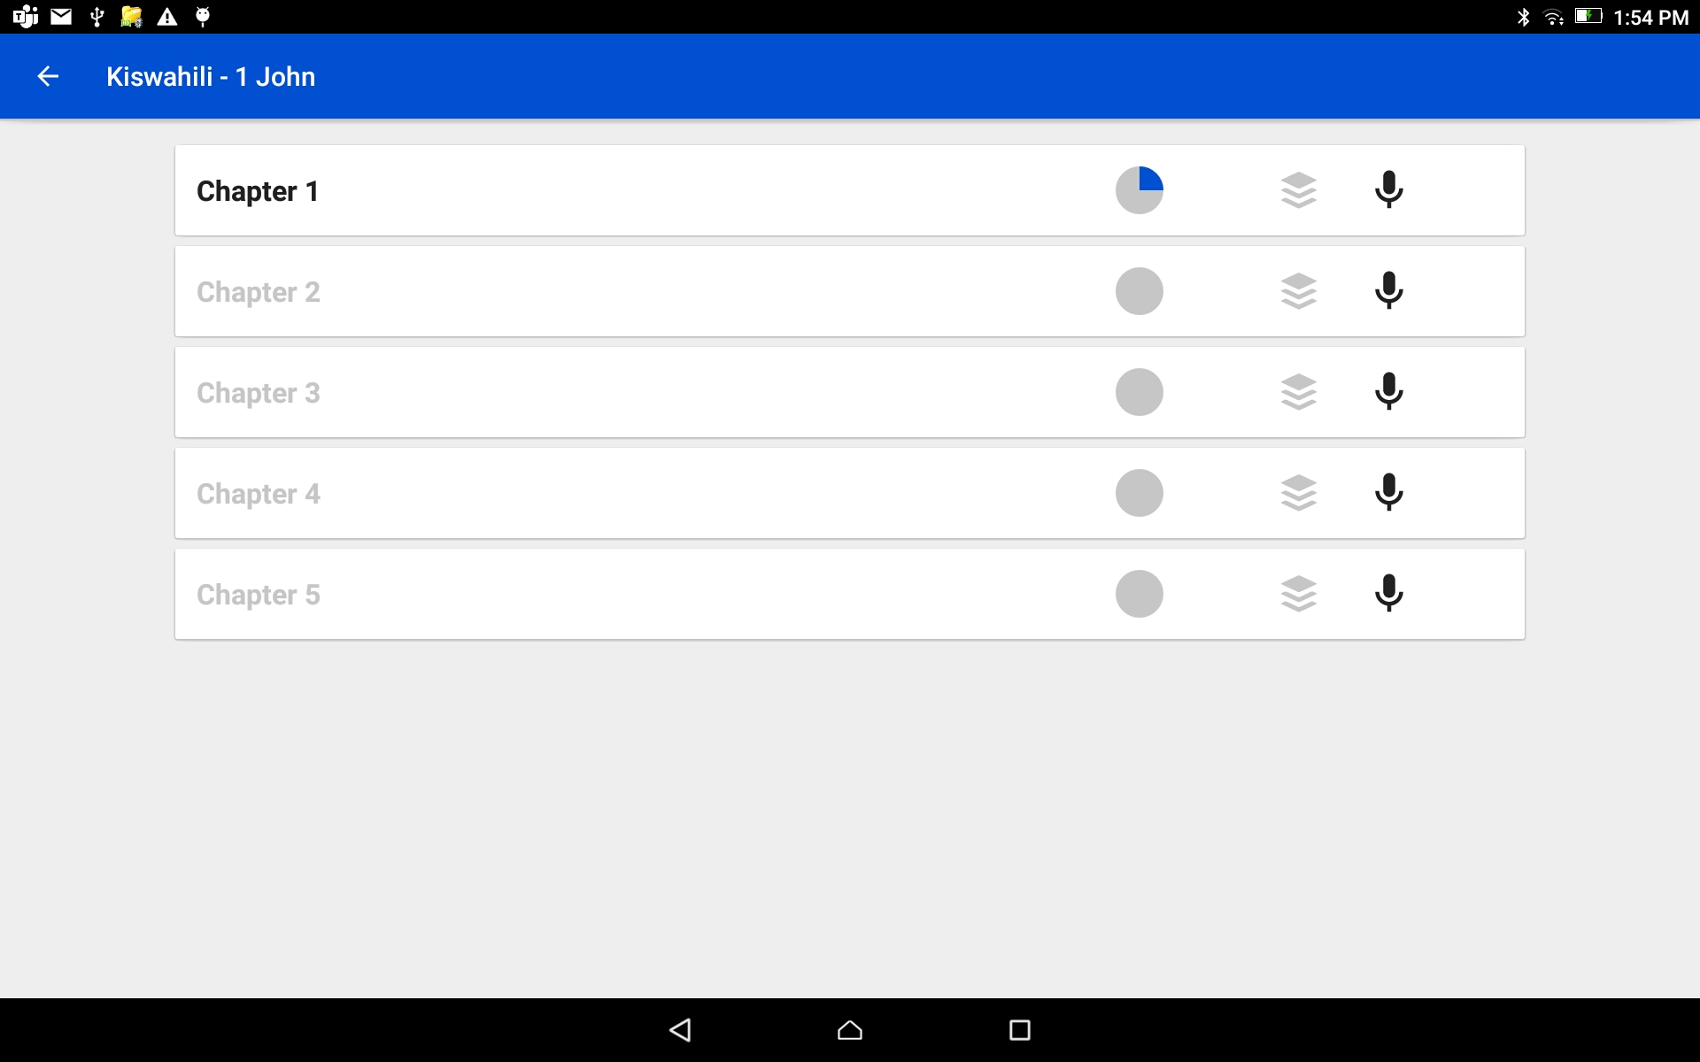

Oral Translations
A chapter that has a partially filled in circle on the bar is not completed.
In Project Management screen
Choose the chapter by tapping on the Chapter bar.
NOTE: Chapters that have recordings are dark black. Chapters that have no recordings are gray.

Slide 15
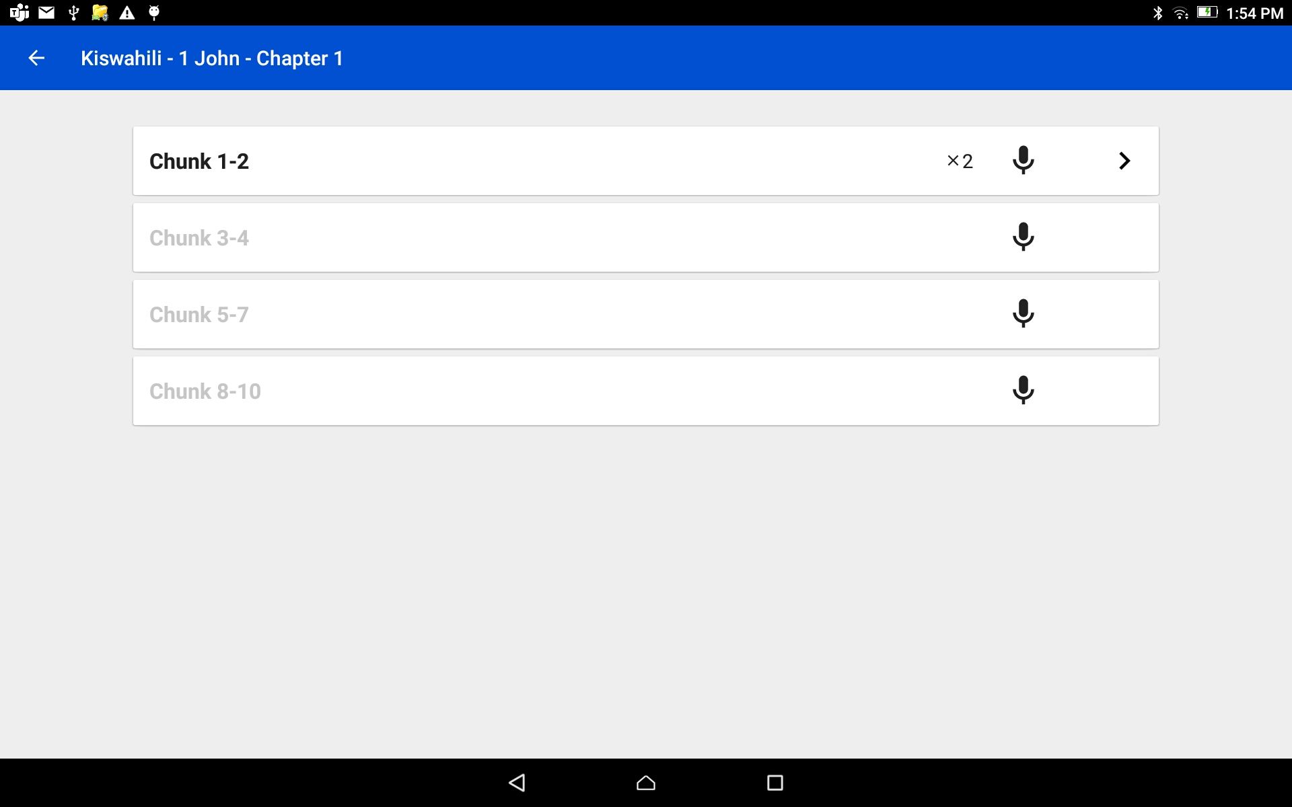
Oral Translations
In Project Management screen
Choose to record the next Verse or Chunk by tapping on the microphone of the next verse or chunk bar that needs to be recorded.
NOTE: the gray verse needs to be recorded.

Slide 16
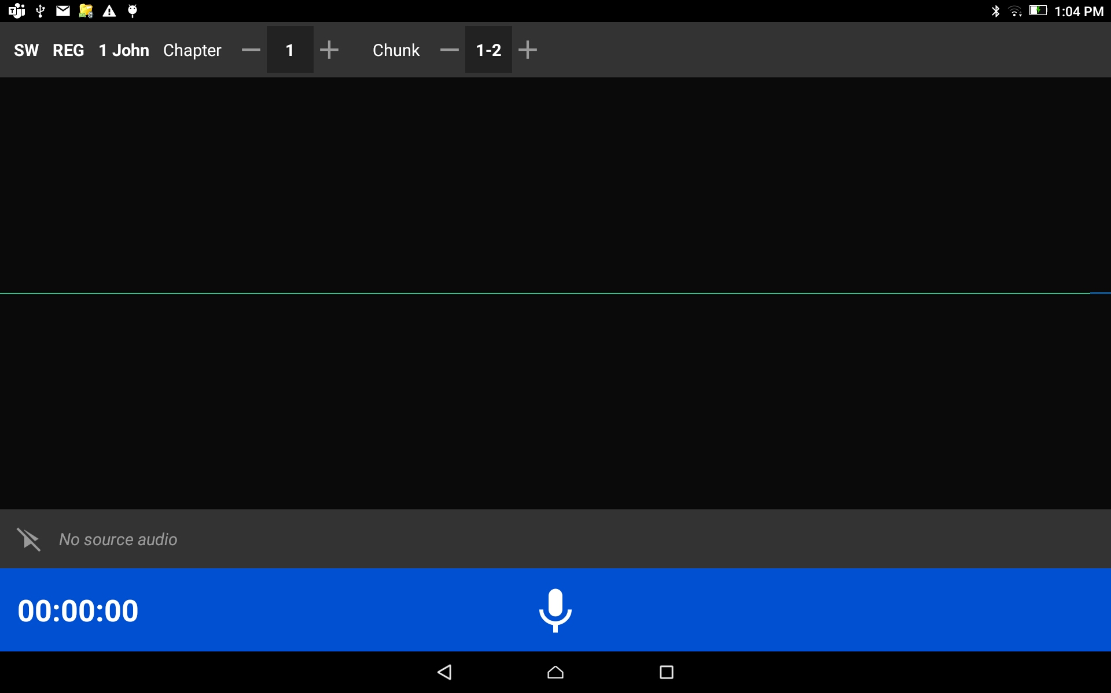
Oral Translations
The Project Opens:
Continue the translating for the next verse or chunk.
Continue these steps – record, save, open next verse - until all of the verses of each chapter is recorded.

